Slide 1

Open, trusted and courageous
Date : November 09, 2017

Slide 2
What We Will Cover...
Who are we & What do we do
How do we test
Automating the (Test) Automation with “DrySel”
Demonstration of “DrySelMagic”
Advantages of using “DrySel”
Announcements
Questions and Answers (Technical Details)

Slide 3

Who are we & What do we do?
We are Orion Health
We are a global Healthcare IT company
We build mission critical software for Hospitals, Health Organizations, Insurance Companies, etc, but most importantly for people/patients
Scottsdale (this office) is one of the development centers of many
Here, we mainly build solutions for Population Health Analysis using cutting edge technologies of big-data and analytics
Java, Scala, Spark, React, JS, Cassandra, ElasticSearch, Selenium, Puppet, Ansible etc are the names a few!

Slide 4

we take testing seriously

Slide 5
We are passionate about Software Quality
Our software impacts people’s life : Software Quality is at the heart of the development lifecycle
We follow Behavior Driven Development (BDD)
Continuous Integration and Continuous Deployment are integral part of our development
Software Engineers are heavily involved in writing unit tests and integration tests
Test Engineers are responsible for Exploratory Testing, API Testing and UI Automation Testing
For UI Automation, we mainly use Java, Selenium and Cucumber
Personally, testing is fun here. There is a lot of freedom and fun to explore new opportunities to enhance and develop.

Slide 6

Automate the (test) Automation

Slide 7



What is DrySel?
“DrySel” is a family of test automation frameworks and tools, developed with a very fundamental software engineering principle “Don’t Repeat Yourself”
✓ DrySelCore, encapsulates “Selenium” entirely
✓ DrySelJSON, pushes definitions of TestObjects (UI & Test Data) out from the code to JSON based resource files
✓ DrySelMagic, the ultimate tool for UI Automation
✓ Removes writing of boiler-plate code from both of the previous frameworks
✓ No “Selenium” code in your tests
✓ Anyone can contribute to test automation
✓ Anyone can automate UI-Testing without writing a single line of code

Slide 8
But tool development was NEVER the first-hand intent ...
Initially, the code I used to write and review was full of repetitions
And I just wanted to remove redundancies in “Selenium” code
“DRY” became the guiding principle
Wrote a lot of small methods with and only with single responsibility
Further abstracting methods into small self contained classes
And classes into related libraries
And libraries, eventually, shaped “DrySel”

Slide 9
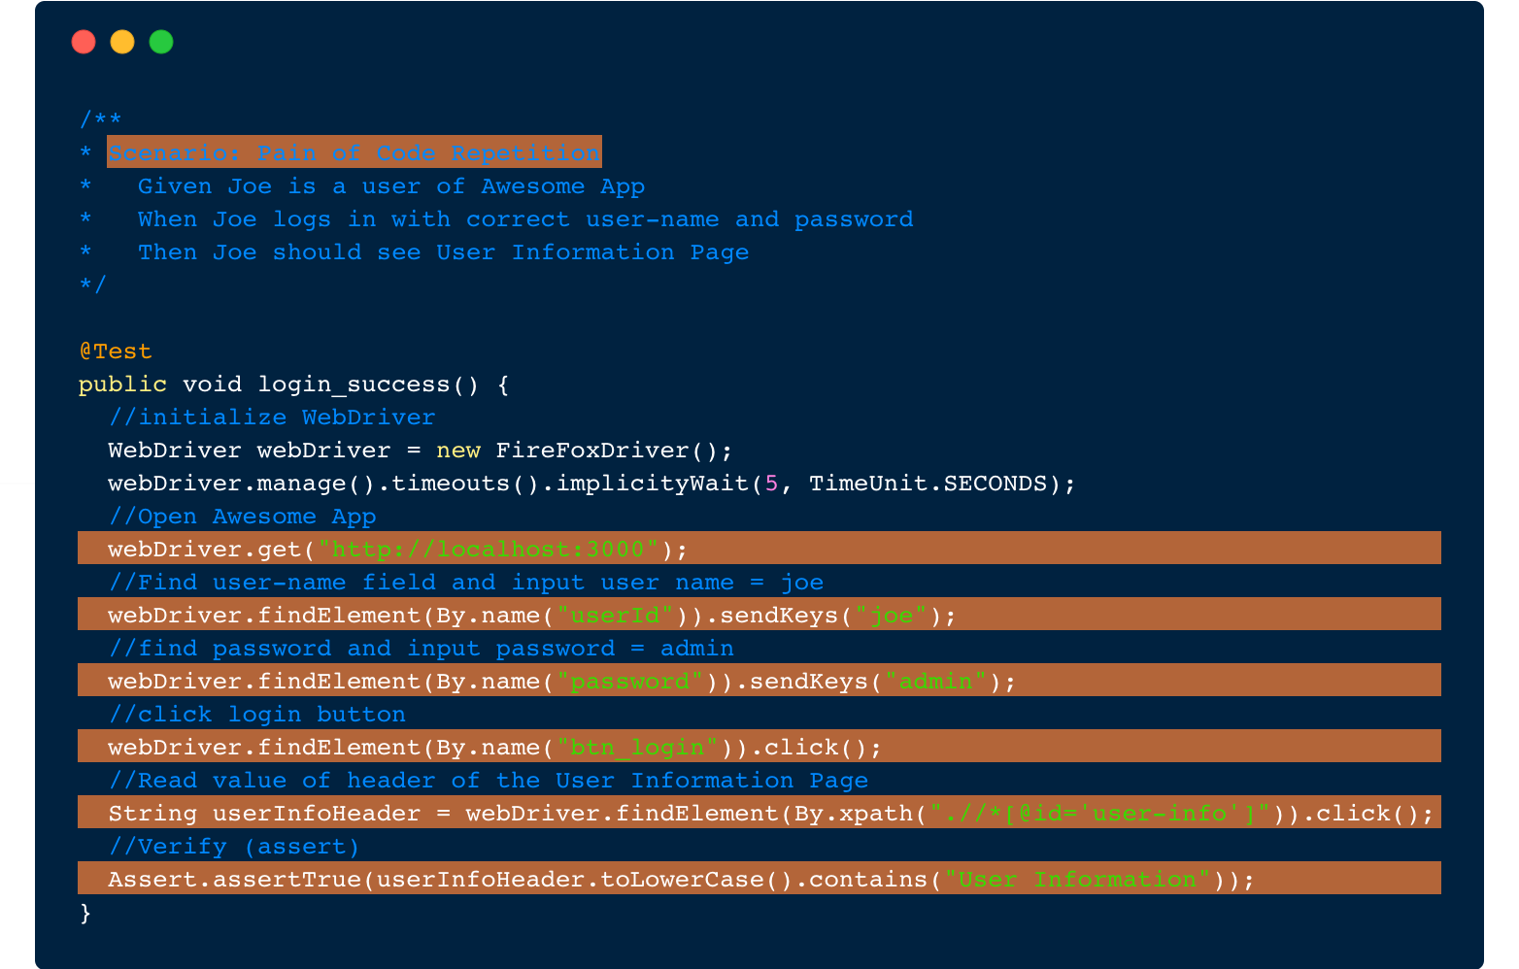

Slide 10

“Stories teach you someThing...”

Slide 11
Story of (Manual) Testing, in general
given ANY application
when I execute test steps
then I should get the output from the application
The Lesson this story teaches me is ...
“Good Tests Require No More Than 3 Method Calls”

Slide 12
So what’s the story of UI Test Automation?
given ANY user interface (UI)
when test data are provided
then the test should be executed
The Lesson this story teaches me is…
An ideal automation tool saves you from knowing “How” and encourages you to focus more on “What”

Slide 13

“Drysel Magic” in action

Slide 14
Let’s do an exercise with a Real Story
given Joe is a user of my “Awesome App”
when Joe enters user name = “Joe” and password = “admin”
then Joe should see “User Information Form”

Slide 15
Advantages of DrySel
No code is the best code.
DrySelMagic eliminates need to write a single line of code.
Coding “Selenium” is entirely removed with all the encapsulations handled by DrySelCore.
DrySelJSON allows anyone to contribute writing Test Objects (objects representing UI and Test Data) in easy to understand, domain specific JSON format.
DrySel promotes collaboration. Be it a manual test engineer, or a seasoned automation engineer, or a business analyst, or anyone else, with little orientation anyone can contribute in test automation. Personally, its a huge win.
The layered architecture allows your seasoned automation engineers to harness powerful features of underlying frameworks.
The frameworks are small, easy to understand and enhance.

Slide 16

Announcement # 1

Slide 17

“DrySel” is open sourced

Slide 18
We are proud to announce that “DrySel” is now FOSS!
We have open sourced ALL 9 projects included in the “DrySel” family of automation frameworks and tools.
All of the projects are licensed under Apache 2.0 License. The license is known to be very permissive. Use it the way you like.
GitHub URL : https://github.com/orion-analytics
Feel free to contribute, the projects are still in their early stages

Slide 19
Technical Details,
Questions and Answers
I am @KuldeepSinhC

Slide 20
Announcement # 2

Slide 21
Join us, We are looking for...
1. Test Engineers
2. software developers

Slide 22
Thank You!

